Slide 1









Recipe api project
MESSAOUD BEN ALI HADDAD

Slide 2





Introduction
In the realm of culinary exploration, recipes serve as the fundamental building blocks, much like the essential components that shape our daily meals. Our culinary experiences are crafted through the careful combination of diverse ingredients, resulting in a symphony of flavors, aromas, and textures that delight our senses.In the kitchen, much like in the broader environment, there is an art to balancing elements. Cooking techniques, whether it's the sizzle of ingredients in a pan or the gentle simmering of a stew, contribute to the unique outcomes we aim to achieve. The act of creating a recipe mirrors the creativity and innovation observed in various fields.

Slide 3




Project overview
In summary, the Recipe API project provides a versatile and secure platform for managing recipes, offering CRUD operations, authentication, external API integration, and error handling. The collaboration with the open-source Recipe API from Rapid API enhances its utility by providing a vast repository of recipes for users to explore and enjoy.

Slide 4
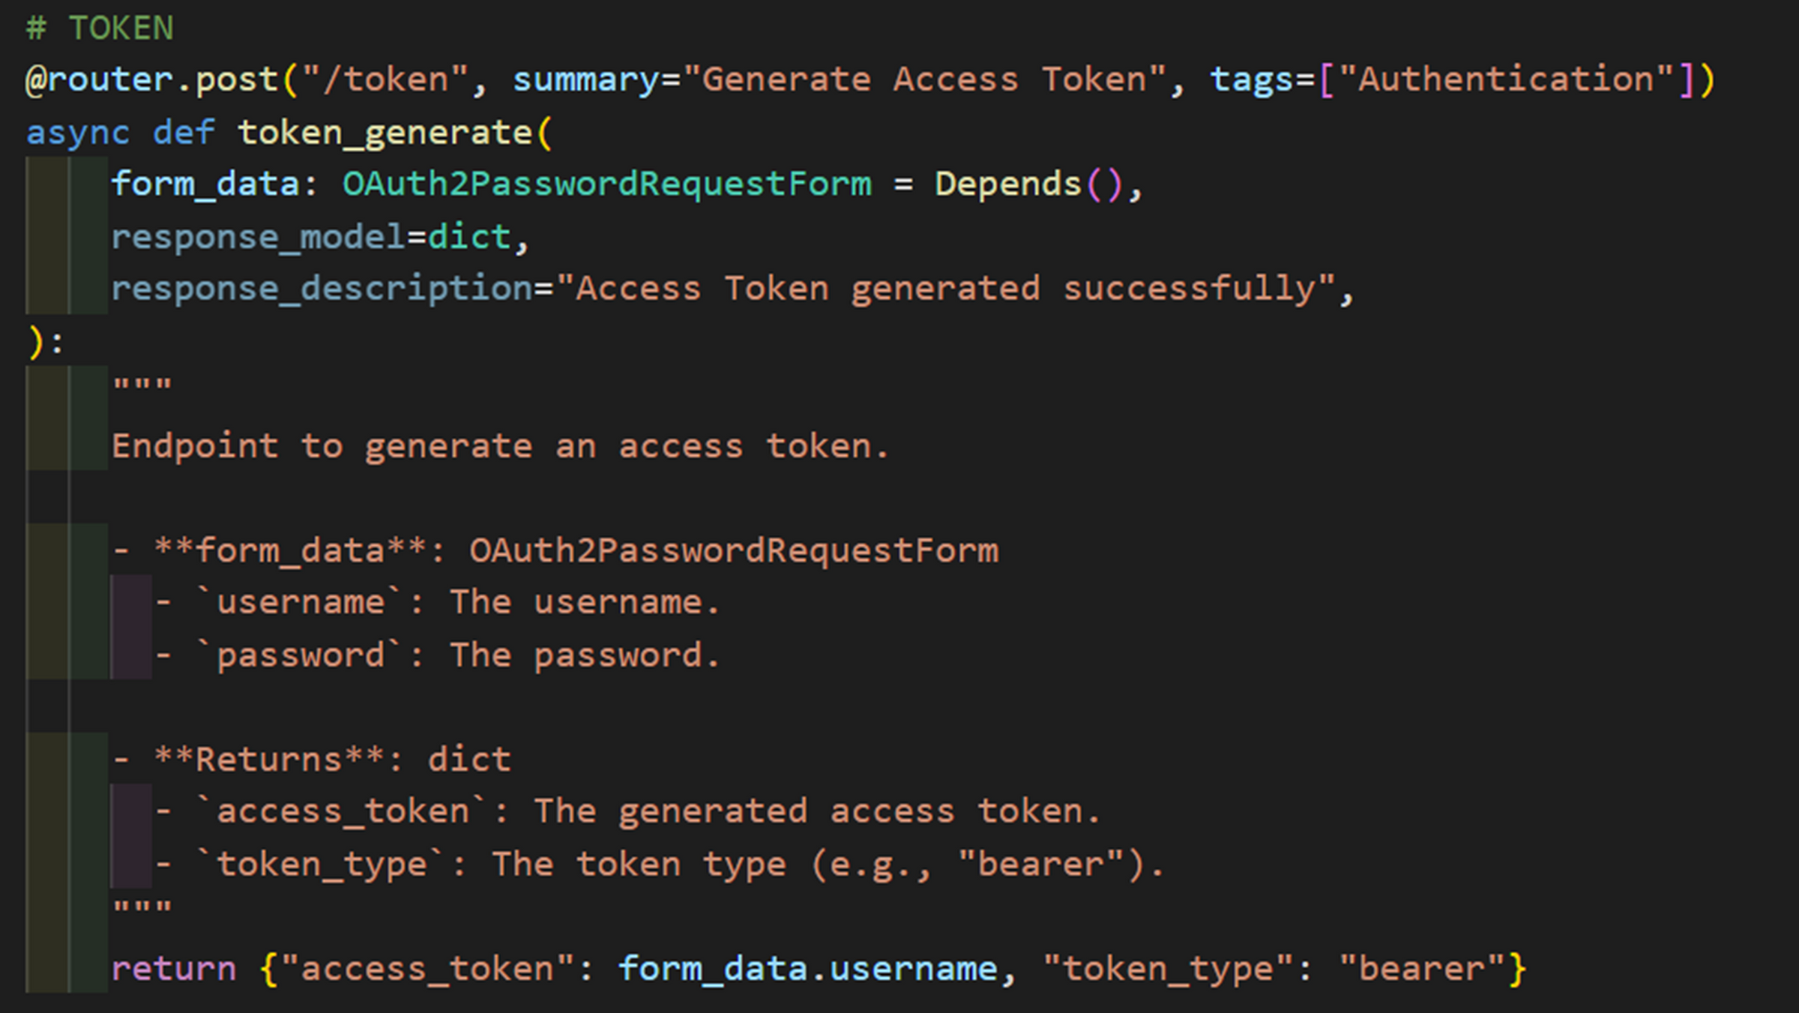

Slide 5


OAuth 2.0
1Client Registration
User Authentication
Token Request
Before interacting with an OAuth 2.0 system, a client (an application or service) must register with the authorization server. This involves obtaining a client identifier and, in some cases, a client secret
The user is prompted to authenticate themselves with the authorization server. Once authenticated, the authorization server asks the user to grant or deny the requested permissions
The client, now armed with the authorization grant, requests an access token from the authorization server. This request includes the grant type and client credentials.

Slide 6
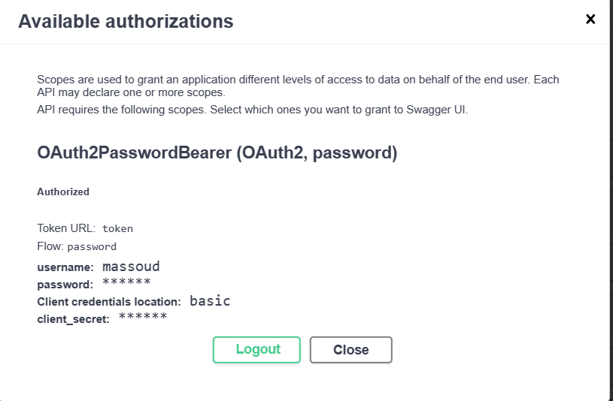

Slide 7
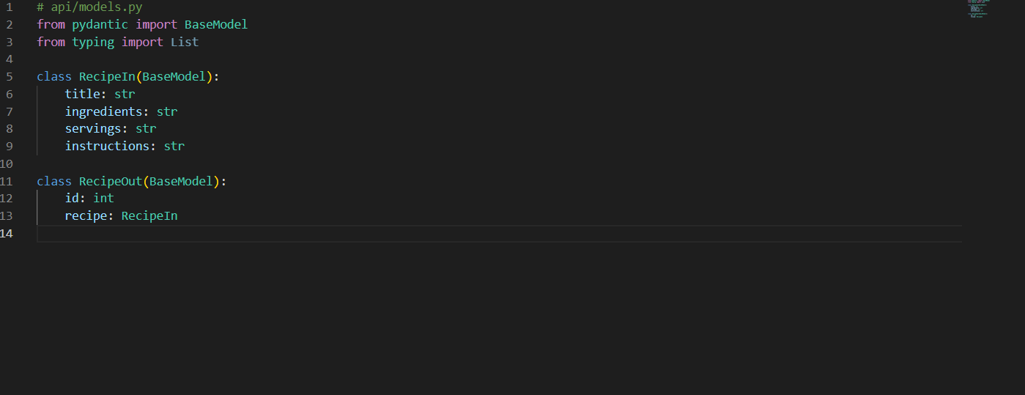

Slide 8
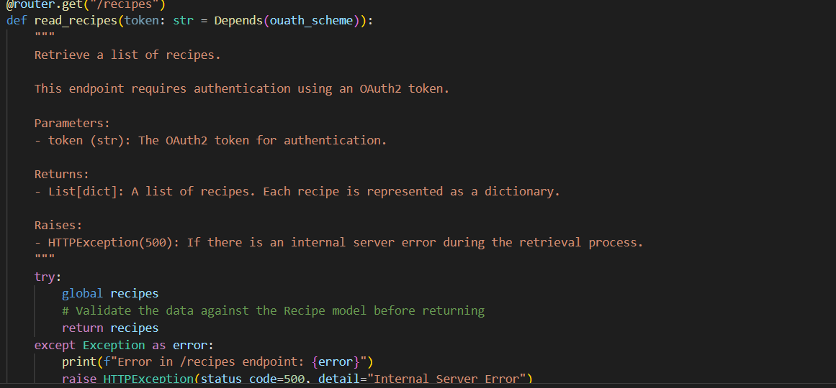

Slide 9
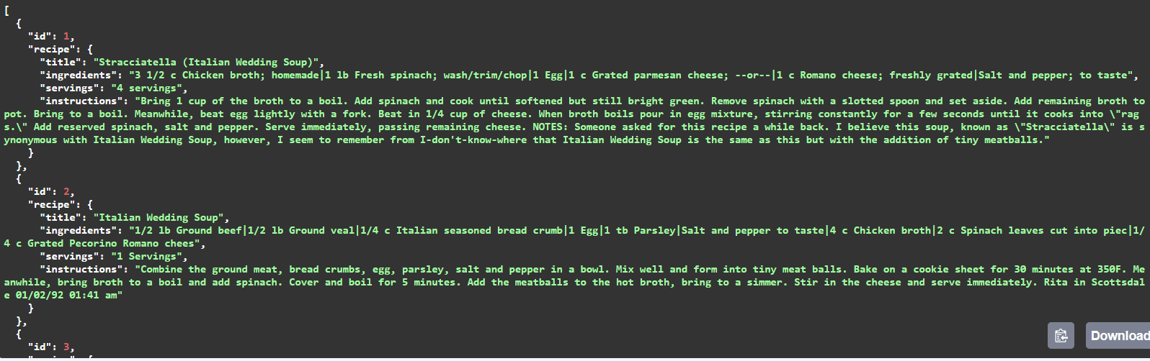

Slide 10


THANK YOU

